Slide 1

HIGH CLOUD AIRLINES DATA ANALYSIS

Slide 2
HIGH CLOUD AIRLINES DATA ANALYSIS PROJECT: P637 GROUP NO: 2
DONE BY:-
MS. NITHYASRI RAMDAS
MR. VIRAL HEMENDRA YADAV
MR. MUTHYALA CHAITHANYA
MS. JISHITHA PONTHALA
MR. OM PRAKASH BEHERA

Slide 3
AGENDA
INTRODUCTION
DATA SOURCE AND TOOLS
BUSINESS OBJECTIVES AND KEY FINDINGS
OVERVIEW
VISUALIZATIONS
FACTORS OF THE AIRLINE INDUSTRY
RECOMMENDATIONS
KEY INSIGHTS
CONCLUSION

Slide 4
01 Introduction

Slide 5
High Cloud Airlines Offers airline companies valuable insights into market trends, customer behavior, and operational performance.
In this project, we aim to analyze and present the top routes (from to city) based on the number of flights, along with identifying the load factor occupied on weekends verses weekdays.

Slide 6
02 Data Sources and Tools Used

Slide 7




Data Source: HIGH CLOUD AIRLINE

Slide 8
03 Business Objectives and Key Findings

Slide 9
Business Objectives & Key Findings
The High Cloud Airlines Project aims to enhance the overall customer experience by delivering personalized services and seamless digital interactions , which will lead to increased passenger satisfactions. Additionally, the project focuses on boosting operational efficiency by optimizing flight operations, Reducing delays, and improving on-time performance. Finally ,the project seeks to increase revenue streams by diversifying income through providing necessary support towards services and strategic partnerships.

Slide 10
04 OVERVIEW

Slide 11
Overview
The airline industry is a complicated sector that operates globally, encompassing major, regional, and low-cost carriers. These airlines manage various fleets and operate within a complex ecosystem shaped by economic conditions, fuel prices, and regulatory standards. Revenue stream include passenger ticket sales, cargo transport, and ancillary services.
It is the dynamic industry influenced by various factors requiring adaptability, strategic planning and a commitment to safety and customer satisfaction for a long-term success
A Purpose of analyzing the data of airline industry serves as a fundamental tool for improving efficiency, making informed decisions, and staying competitive in a dynamic and challenging business environment. It helps airlines navigate operational complexities, mitigate risks, enhance overall performance.
Data Analyzed in the form of relational, graphs and document data models using tools like Excel, Tableau, PowerBI and SQL
Let examine the dashboards where we have used Load factor as the key for performance of the airlines

Slide 12
05 Visualization

Slide 13
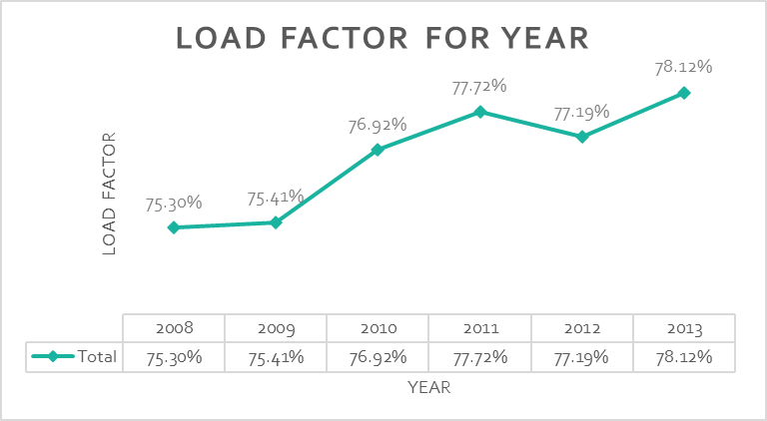
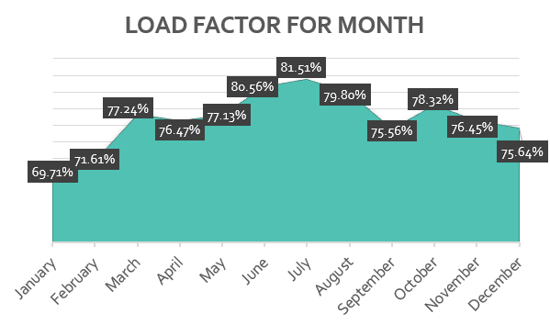
Find the load Factor percentage on a yearly Quarterly and Monthly basis
2013 has the highest load factor with 78.12% and 2008 has the lowest load factor with 75.30%.
There is a gradual increase throughout the years, ensuring more seat occupancy.
Load factor in June, July, and August period of months has the highest indicating that the passengers most preferred month period to travel.
Q1 is less preferred traveling period with a 72.98% load factor which is low compared to other quarters.

Slide 14
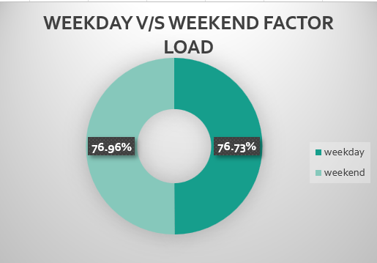
Identify how much load factor is occupied on Weekends vs Weekdays.
The occupancy rate on weekdays at 76.96% is more than on weekends at 76.73% indicating that the flight seats are filled approximately equal in both weekdays and weekends

Slide 15
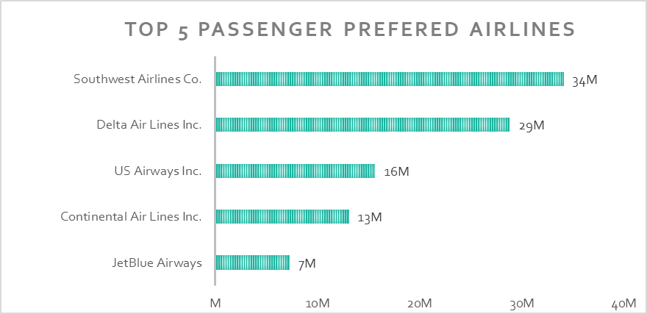
Identify the Top 5 Airlines based passenger preference
Southwest Airlines co with 34M passengers traveled all time
Delta Airlines Inc. with 29M secures the second position
JetBlue Airlines is the least preferred with 7M passengers

Slide 16
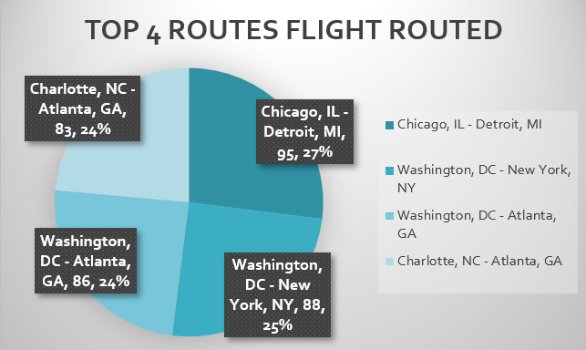
Display top Routes (from to City) based on the Number of Flights
Chicago to Detroit route is the most preferred route with the highest no: of passengers travelled with 27%.
Charlotte, NC-Atlanta, GA and Washington, DC-Atlanta, GA is the least popular routes with only a 24% travel rate

Slide 17
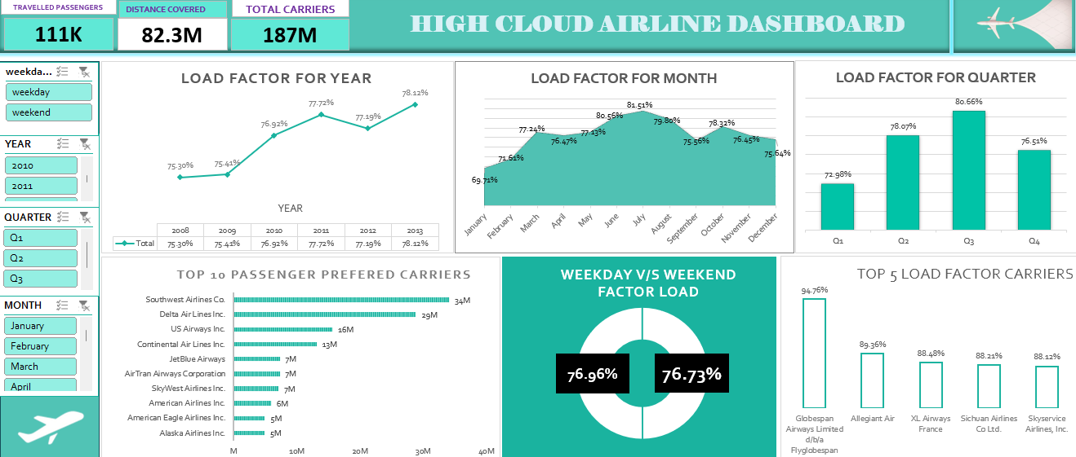
Dashboard

Slide 18
06
FACTORS OF THE AIRLINE INDUSTRY

Slide 19
Key Factors of the Airline Industry
Structure
Strategic Alliances
Marketing and Branding
Outsourcing
Technology
Culture
Planning and Forecasting

Slide 20
07 RECOMMENDATIONS

Slide 21
Increase Weekend and Weekdays Flights and Promotions
Adding more flights on weekends and weekdays to accommodate demand.
Introducing promotions or special deals for family trips and leisure travel during weekends to further increase occupancy rates.
2. Promote Long-Distance Flights
Promote long-distance flights through loyalty programs or discounted prices.
Focus on improving services for these routes to retain and attract more customers.
3. Analyze and Optimize Low-Performance Routes
Either reduce flights on such routes or discontinue them if they are not profitable.
Consider shifting resources to higher-demand routes
4. Focus on Customer Preferences
Improve in-flight services, offer more flexible pricing models, and enhance the passenger experience to improve their own preference rankings.

Slide 22
08 KEY INSIGHTS

Slide 23
Key Insights
KEY INSIGHTS: It's important to tailor the analysis to the specific goals and questions of the project. By diving into the data with a focused approach, you can cover actionable insights that can inform strategic decisions, improve operational efficiency, and contribute to the overall success of the airline.
COMPETITION
Focus on Intense competition, especially in popular routes
FINANCIAL STABILITY
Evaluate overall cost structures and Identify opportunities for cost optimization and efficiency improvements
FLEET COMPOSITION
Evaluate Fleet composition which is influenced by the types of routes and passenger demand.
ONTIME PERFORMANCE-
Identify the overall on- time performance of flights and explore any patterns or trends in delays or cancellations
GROWTH OPPORTUNITIES
Identify high-demand routes and potential growth opportunities based on origin- destination analysis.
MARKET ANALYSIS
Evaluate the performance of different carriers operating in the market and assess market share
DEMAND ANALYSIS
Understand the performance and demand patterns. across different cities, states, and countries

Slide 24
What have we learned from this Project?
Load factor is a key metric for benchmarking an airline's performance against competitors. Airlines may compare their load factors with industry averages to assess their relative position in the market.
Based on the available data, we have analyzed 207 airlines, spanning 4 regions, operating in 106 countries and serving 1327 cities.
As per the Analysis 2013(78.12%) has the highest load factor and 2008(75.30%) has the lowest load factor which directly impacts the airlines’ financial performance.
Regarding the load factor, we observed that the airline capacity is equal on weekdays and weekends, indicating approximately equal passenger travel during both weekdays and weekends.
Also, Globespan Airways has the highest load factor which is 94.76 %.
Airlines known for consistently high load factors may be perceived as operationally efficient and capable of maximizing revenue through effective capacity utilization and can be successful in revenue generation
Passengers often associate crowded flights with popular routes and may choose carriers with higher load factors for a sense

Slide 25
09 CONCLUSION

Slide 26
CONCLUSION
The analysis of passengers’ travel preferences and Airline Performance highlights a clear opportunity for airlines to enhance their business operations.
By aligning flight schedules with passengers’ preferences and focusing on areas of high demand airlines can improve profitability and capitalize on growth opportunities. By adopting a proactive approach informed by data-driven insights, airlines can navigate the dynamic aviation landscape with confidence, ensuring sustainable growth and success in the market.

Slide 27
Thank You

